Slide 1
House Price Prediction
Group 2:
Jesus Perez
Georgios Filippos Bogdos
Gideon Koech

Slide 2
Outline
01
Introduction & Problem Statement
Description of the research problem
02
04
Dataset
Results and Evaluation
Description of dataset used
Evaluation of our models
03
05
Prediction Methods
Challenges and Conclusion
Explanation of the methods utilized
Challenges faced and conclusion

Slide 3
Introduction & Problem Statement
Subjective traditional methods of housing price.
Significant research study into housing market.
AI & house price shifts
Lack of accurate measures of house prices despite the vast amount of data.
Lack of AI utilization in building housing projection models
Difficulties in estimating house market prices.
The “Hedonic model”.
US house market history.
Research Question
Evaluating how well AI methods perform in comparison to one another.
Estimating median house value in California.

Slide 4
Dataset
California Housing dataset contains information on the housing prices in various districts in California.
Median House Value
Housing Median Age
Longitude & Latitude
The data set contains 20,640 instances with 8 features each.
The median house value is the target variable in this dataset, with a range of values from $14,999 to $500,001.
Total Rooms
Total Bedrooms
Population
Households

Slide 5
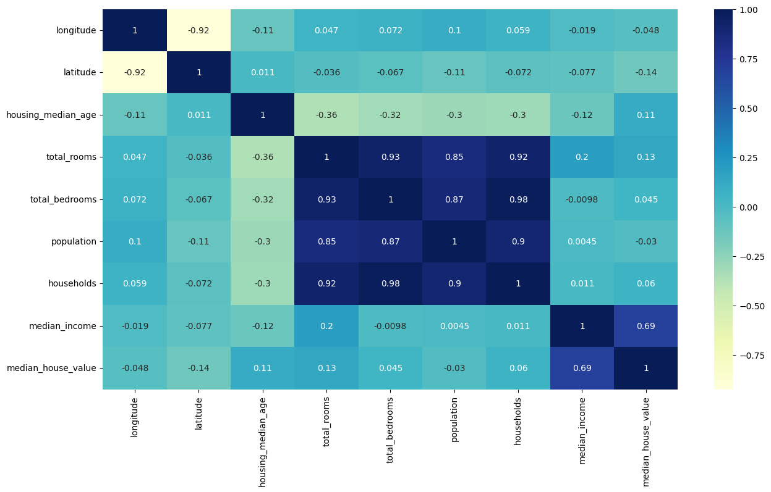
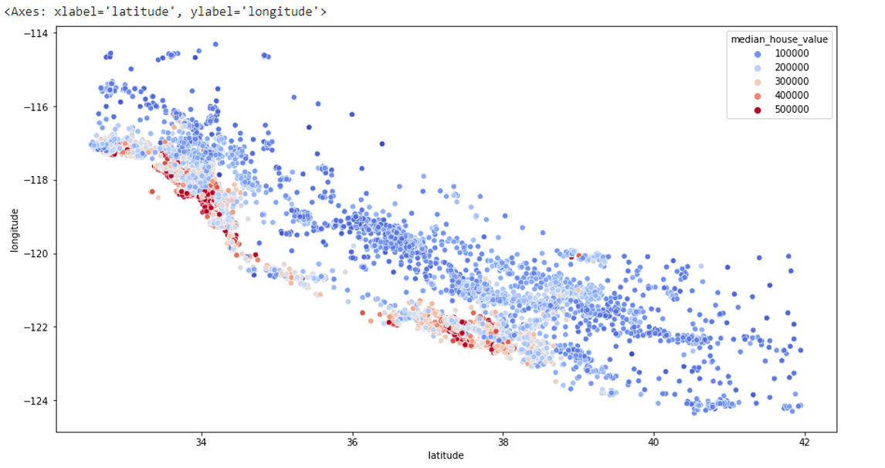
Dataset Visualization
Setup
Google Colab
Python Libraries:
Pandas, Scikit-Learn, Seaborn, Keras, Xgboost
Notes:
Correlation Analysis Heat Map- used for correlation study to find what pairs are highly correlated.
Graphical Map Representation of the Latitude & Longitude

Slide 6
Prediction Methods
Linear Regression
Describes the relationship between variables by fitting a line to the data that has been gathered
Random Forest Regression
Supervised learning technique that utilizes the ensemble learning approach to perform regression
LSTM
Uses a group data to be the input and finally produce one output. This output value will affect the parameters of the LSTM system for the next iteration.
XGBoost
When all the predictions are combined, bad predictions cancel out and better one sums up to form final good predictions.
XAi
Creates system that is more transparent, interpretable, and accountable.
Notes:
Linear Regression: Utilizing a technique known as simple linear regression, one can get an estimate of the relationship that exists between two quantitative factors.
Random Forest: Random Forest Regression is a supervised learning technique that utilizes the ensemble learning approach to perform regression (Segal, 2004). The ensemble learning method is a methodology that combines predictions generated by multiple machine learning algorithms to produce a forecast that is more accurate than a single model's prediction.
During the training phase of a Random Forest operation, several decision trees are built. After this phase is complete, the Random Forest generates the mean of the classes as the prediction for all the trees. To have a better understanding of how the Random Forest algorithm works, let's go over each step one at a time:
XGBoost: XGBoost is an implementation of gradient boosted decision trees designed for speed and performance. Gradient Boosting is a machine learning algorithm, used for both classification and regression problems. It works on the principle that many weak learners (eg: shallow trees) can together make a more accurate predictor.

Slide 7
Methodology
Data Exploration
Load data into our code, view and analyze the data set loaded
Data Preprocessing
Check for duplicates, remove missing values, remove missing values and scale data
Feature Engineering
Feature Engineering
Transform and generate new features
Data Preprocessing
Model Training
Model Training
Model selection and hyperparameter training
Data Exploration
Model Evaluation
Model Evaluation
R squared performance evaluation matrices used to evaluate regression models

Slide 8
Evaluation
R2 (Squared)
.68
Linear Regression
Random Forest Regression
.82
???
Was expected to be the best
Long-Short Term Memory
.84
eXtreme Gradient Boosting
.67
Lasso Regression
Notes:
When developing machine learning models, it's important to keep track of how well our model performs.
(R2) - measures how well a statistical model predicts an outcome. You can interpret the R2 as the proportion of variation in the dependent variable that is predicted by the statistical model.

Slide 9
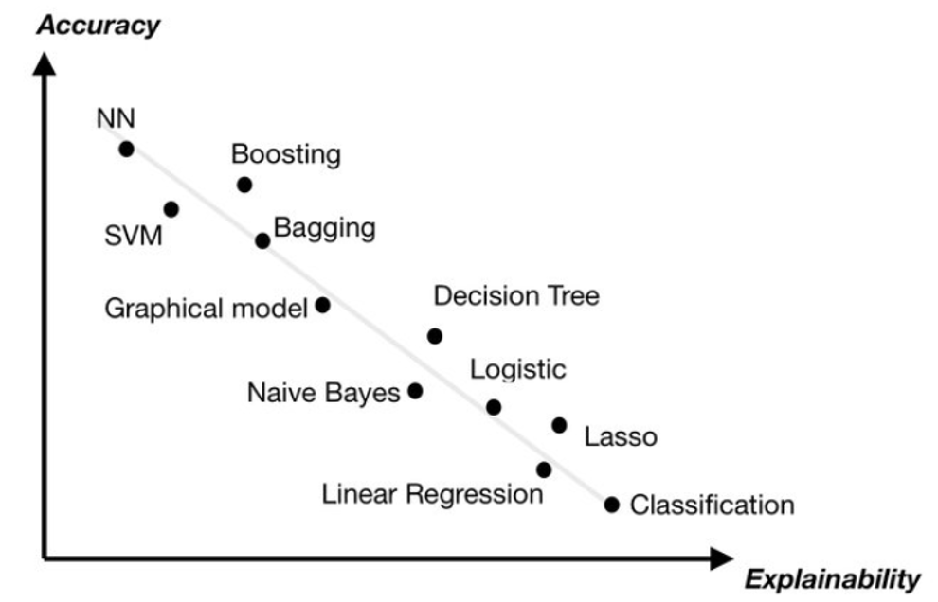
XAI (Novel Idea Attempt)
Explainable AI (XAI) is an area of artificial intelligence (AI) research that focuses on creating AI systems that can explain their decisions and behaviors.
XAI seeks to create AI systems that are more transparent, interpretable, and accountable. This is important for ensuring that AI systems are used responsibly and ethically.
XAI techniques such as feature importance, partial dependence plots, and counterfactual explanations can help to explain the decisions made by AI systems and provide insights into how they work.

Slide 10
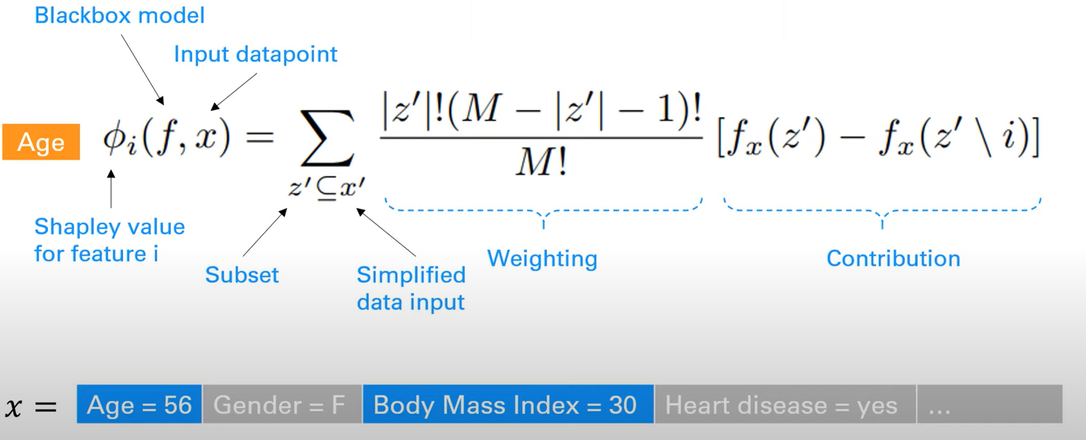
XAI
•SHAP is a mathematical method to explain the predictions of machine learning models.
•It is based on the concepts of game theory and can be used to explain the predictions of any machine learning model by calculating the contribution of each feature to the prediction.
•For each feature, SHAP value explains the contribution to explain the difference between the average model prediction and the actual prediction of the instance.
•It also explains the contribution of different combinations of features.

Slide 11
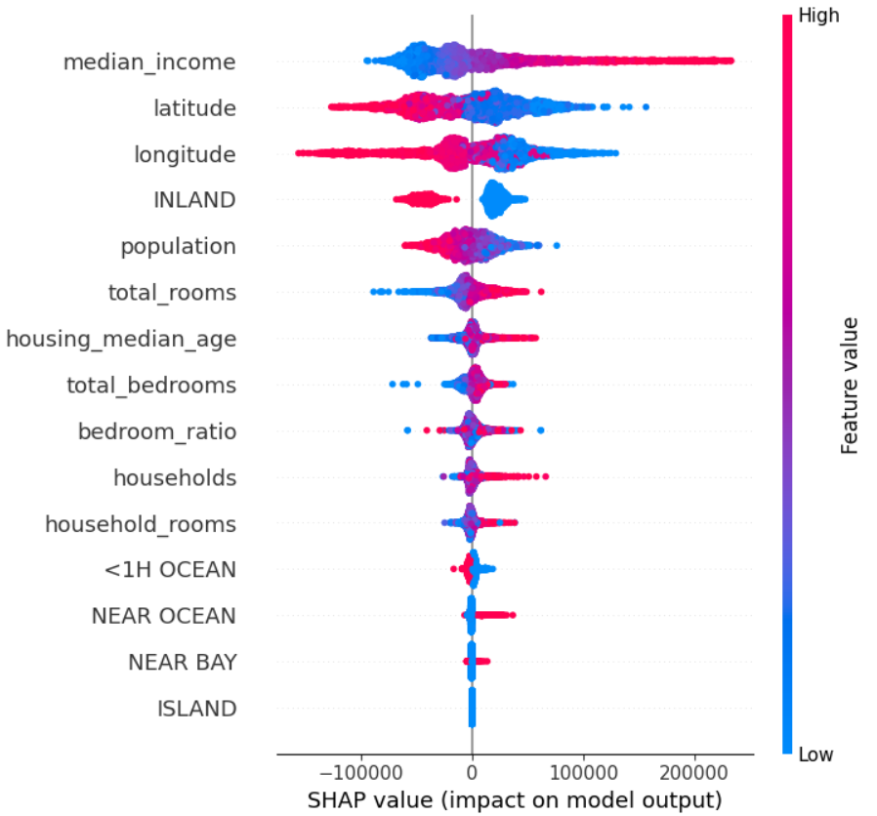
SHAP Results

Slide 12
Challenges
01
LSTM was expected to give us the best prediction, but there was issues with our algorithm working correctly
02
There are multiple factors that can influence the price depending on the location.
03
Limited by computing power

Slide 13
Conclusion
Using California dataset, the group has tried to fit different types of regression models, which include Simple Linear Regression Model, Lasso Regression Model and the Random Forest Model. We are finding the XGBoost model as the most appropriate model giving the highest values of the R-square.
Hence, it can be concluded that the XGBoost model is the most appropriate model for this dataset
Our research has demonstrated that advanced machine learning algorithms such as LR, RF, and Lasso are viable tools for real estate researchers to use in predicting house prices. However, we must keep in mind that these machine learning tools have limitations of their own.

Slide 14
References
Prasad, K. Venkata, and K. Ravindra. "A comparative study of regression models
for prediction of house prices in Ames, Iowa." Journal of Construction Engineering and Management
138, no. 4 (2012): 499-508.
Singh, R. K., and S. Singh. "Predicting housing prices with machine learningtechniques." International
Journal of Computer Applications 173, no. 7 (2017): 1-7.
Soni, N. K., and N. P. Goyal. "Housing price prediction using machine learning
techniques: A review." arXiv preprint arXiv:1809.06354 (2018).

